Slide 1
Natural Language Processing (NLP)
Lecture 12: Text Representation
Dr. Muhammad Taimoor Khan

Slide 2
Preparing Textual Data
To mine text, it has to be presented in a way that can be consumed by data mining techniques (Machine Learning)
Predictive data mining techniques require highly structured data
Text is far from being structured but can be prepared for it

Slide 3
Data Collection
In case of web mining, regularly crawling new content on websites is also a part of data preparation
All real-time applications are directly linked to a continuous data source
Social media analytics also perform real-time or near real-time analysis

Slide 4
A logging application may look for new data after every time interval e.g., emails at a mail server
Resources against certain queries in a search engine
New comments are added to the content in blogs and forums
Dynamic pages are continuously modified

Slide 5
Nature of Data
Text documents may be large e.g., professional articles, journals, magazines, novels, chapters… (touching on background details)
They may be short e.g., Tweets, product reviews, social media comments, chat messages… (missing context)
It may have time-stamp, user location / IP address, source, likes… (with meta-data)

Slide 6
Not all documents can be of help depending on language, subject, subjectivity…
Reuters news stories are widely used for analysis, however, there are more variety of datasets available according to the nature of analysis

Slide 7
Preprocessing
Segmentation
Tokenization
Filtering unknown symbols / characters
POS tagging (POS based filtering)
Lemmatization
Stemming
Case folding
Correcting spelling mistakes
Etc…

Slide 8
Unstructured Data
Semi structured
JSON
XML
Unstructured
Text, PDF, Word
Highly unstructured
Images, Videos etc.

Slide 9
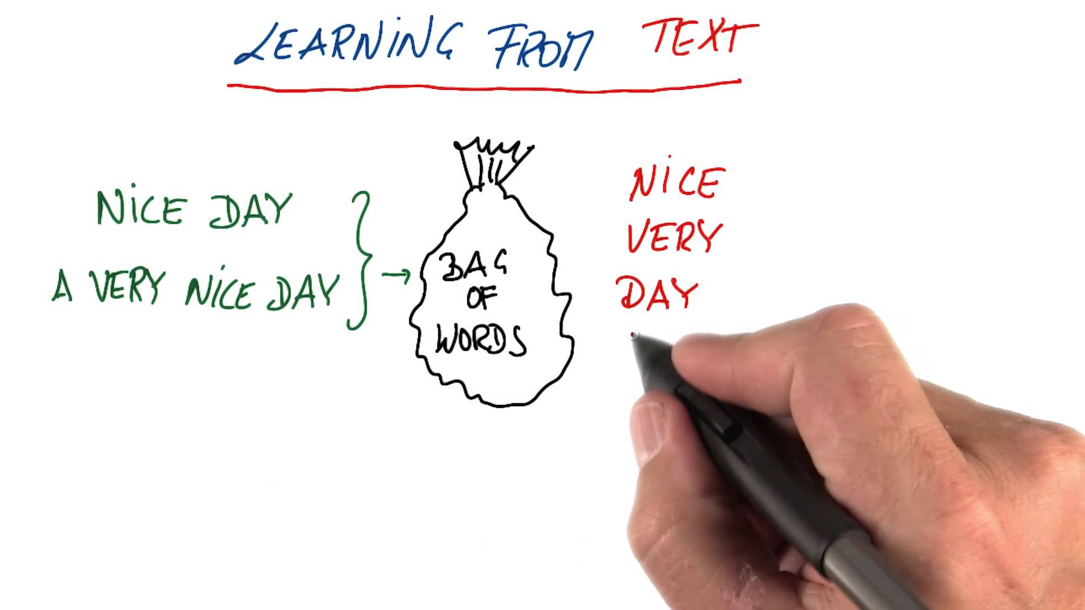
Bag of Words (BoW) Model
We ignore the order of words in a document
But Why!

Slide 10
BoW
Simplifies the problem
For very high number of documents, the BoW model performs well as it still holds the sense maintain in a document
But the position-related information is lost
However, it depends on the nature of the data and/or application

Slide 11
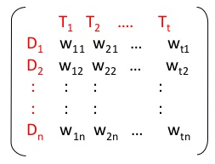
Vector Space Model (VSM)
An algebraic model for representing text as other types of objects
Its like a matrix with documents as objects and words as features
Each document (in rows) is represented as a vector

Slide 12
The words (in columns) represent features
In case of N features the problem is treated as an N-dimensional space (N is usually very high for text)
It’s a huge sparse matrix having most entries as zeros

Slide 13
A cell hold a value for the word in column to the corresponding document in row
Different schemes can be used to calculate the values in the cells
A dictionary / vocabulary is used to represent all unique tokens (Global Dictionary)
Filling up the matrix, makes it available for applying predictive models

Slide 14
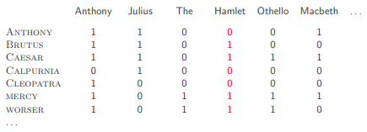
Binary Representation
A word may either exist or does not exist in a document
Frequency is ignored
Each feature as a value from {0, 1}

Slide 15
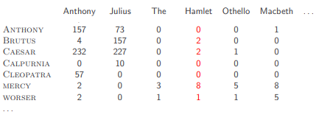
Frequency (Count) Based Representation
The value in a cell is the count of the word in column for the document in row
It associates more weight to a word occurring multiple times i.e., making frequency count
All the words occurring in a document have different weights associated to them

Slide 16
Binary vs Frequency Represenation
Frequency offers more information
Frequency provides higher contrast among documents
Leads to more compact solution in the same solution space
Values have high range (more evaluations incurring extra computations)
Binary is simple light-weight (fewer evaluations)

Slide 17
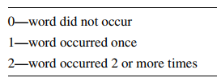
Caped Frequency Representation
Frequency can be irrelevant above a certain threshold
A 3-valued approach can simplify the solution
In general it can be an N-valued approach Where the upper limit be set to any rational value

Slide 18
Lower-Bound Representation
Decide a minimum threshold and zero all entries below that threshold
It’s the least frequency a word need to have to be considered for analysis
A combination of the capped and lower-bound approach can also be used, depending upon the nature of data, model and application

Slide 19

Log Term Frequency
Log dampens the high frequency
At very high frequency, the difference hardly matters
1 is added to separate tf=1 from tf=0 because log₁₀(1) = 0
It assumes that frequency matters but not after a certain value

Slide 20
Weighted Term Frequency
In semi-structured documents, weights can be assigned to words based on their frequency in a specific section
For example, in research papers the count of a word in title, abstract or other parts of the paper conveys different sense of a word.

Slide 21
Assignment #2
Write code to read some text from a text file
Segment on sentences
Represent the data in VSM format
Allow user to choose among different representation schemes studied i.e., binary, frequency, log-freq, caped-freq, lower-bound etc.
Submit your code and demo in a single word file.

